Slide 1
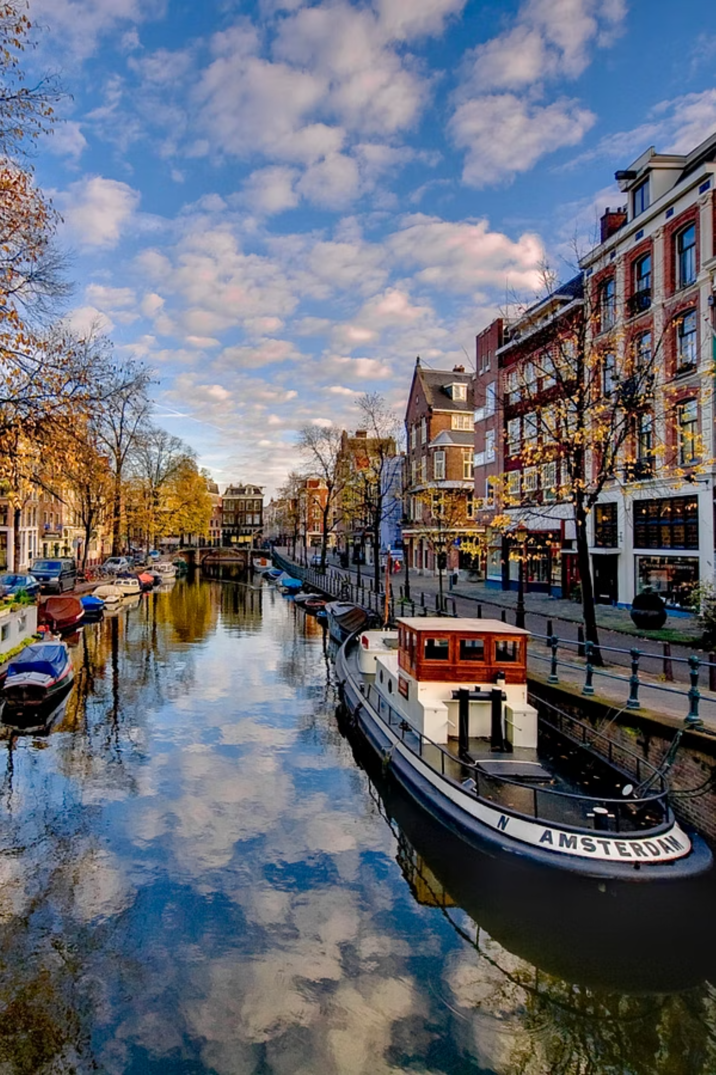
Western Polyarchies
Today, I'll explore Western polyarchies, a concept defining modern democratic systems across numerous Western nations. These systems offer citizens the power to elect their leaders through free and fair processes, safeguarding individual rights and freedoms.
Vaganova Olga
Group № 3834101/30309

Slide 2
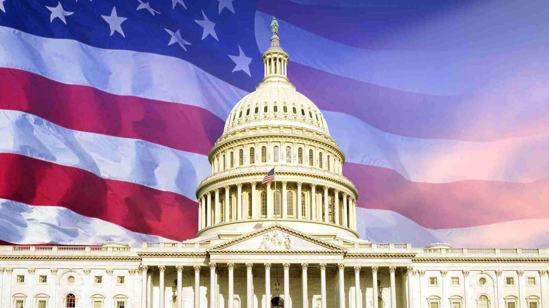


Historical Background
The development of Western polyarchies has deep historical roots.
The idea began to grow in Europe during the Enlightenment in the 17th and 18th centuries.
United States Constitution (1787)
French Revolution
It introduced separation of powers and checks and balances, which became key features of many later polyarchies.
Another major step was the French Revolution, which promoted ideas of equality, citizenship, and political participation.

Slide 3

Where Are They Found?
Primarily, Western polyarchies are prevalent in Western Europe, North America, and Australia. However, similar political characteristics can be observed in various other countries globally, reflecting a shared commitment to democratic principles.
Global Reach
Beyond traditional Western strongholds.
Shared Ideals
Commitment to democratic governance.

Slide 4
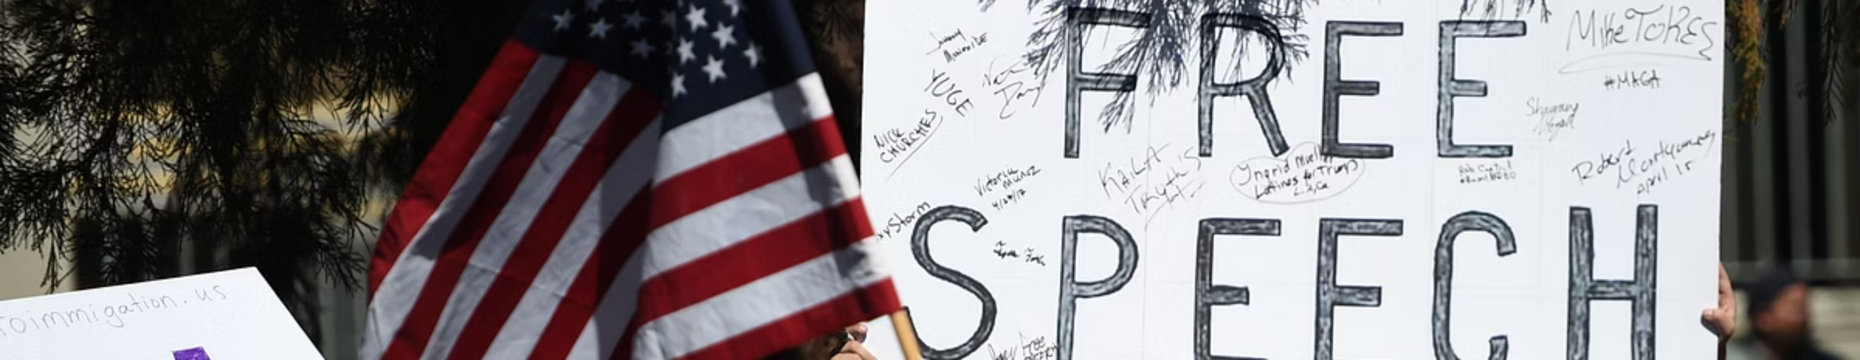
Safeguarding Civil Liberties
A crucial aspect of Western polyarchies is the robust protection of individual freedoms, ensuring citizens feel secure and respected.
Freedom of Speech
Freedom of Religion
Right to Fair Trial
The right to express thoughts and ideas without censorship.
The liberty to practice any faith, or none, without interference.
Ensuring justice and due process for all citizens.

Slide 5
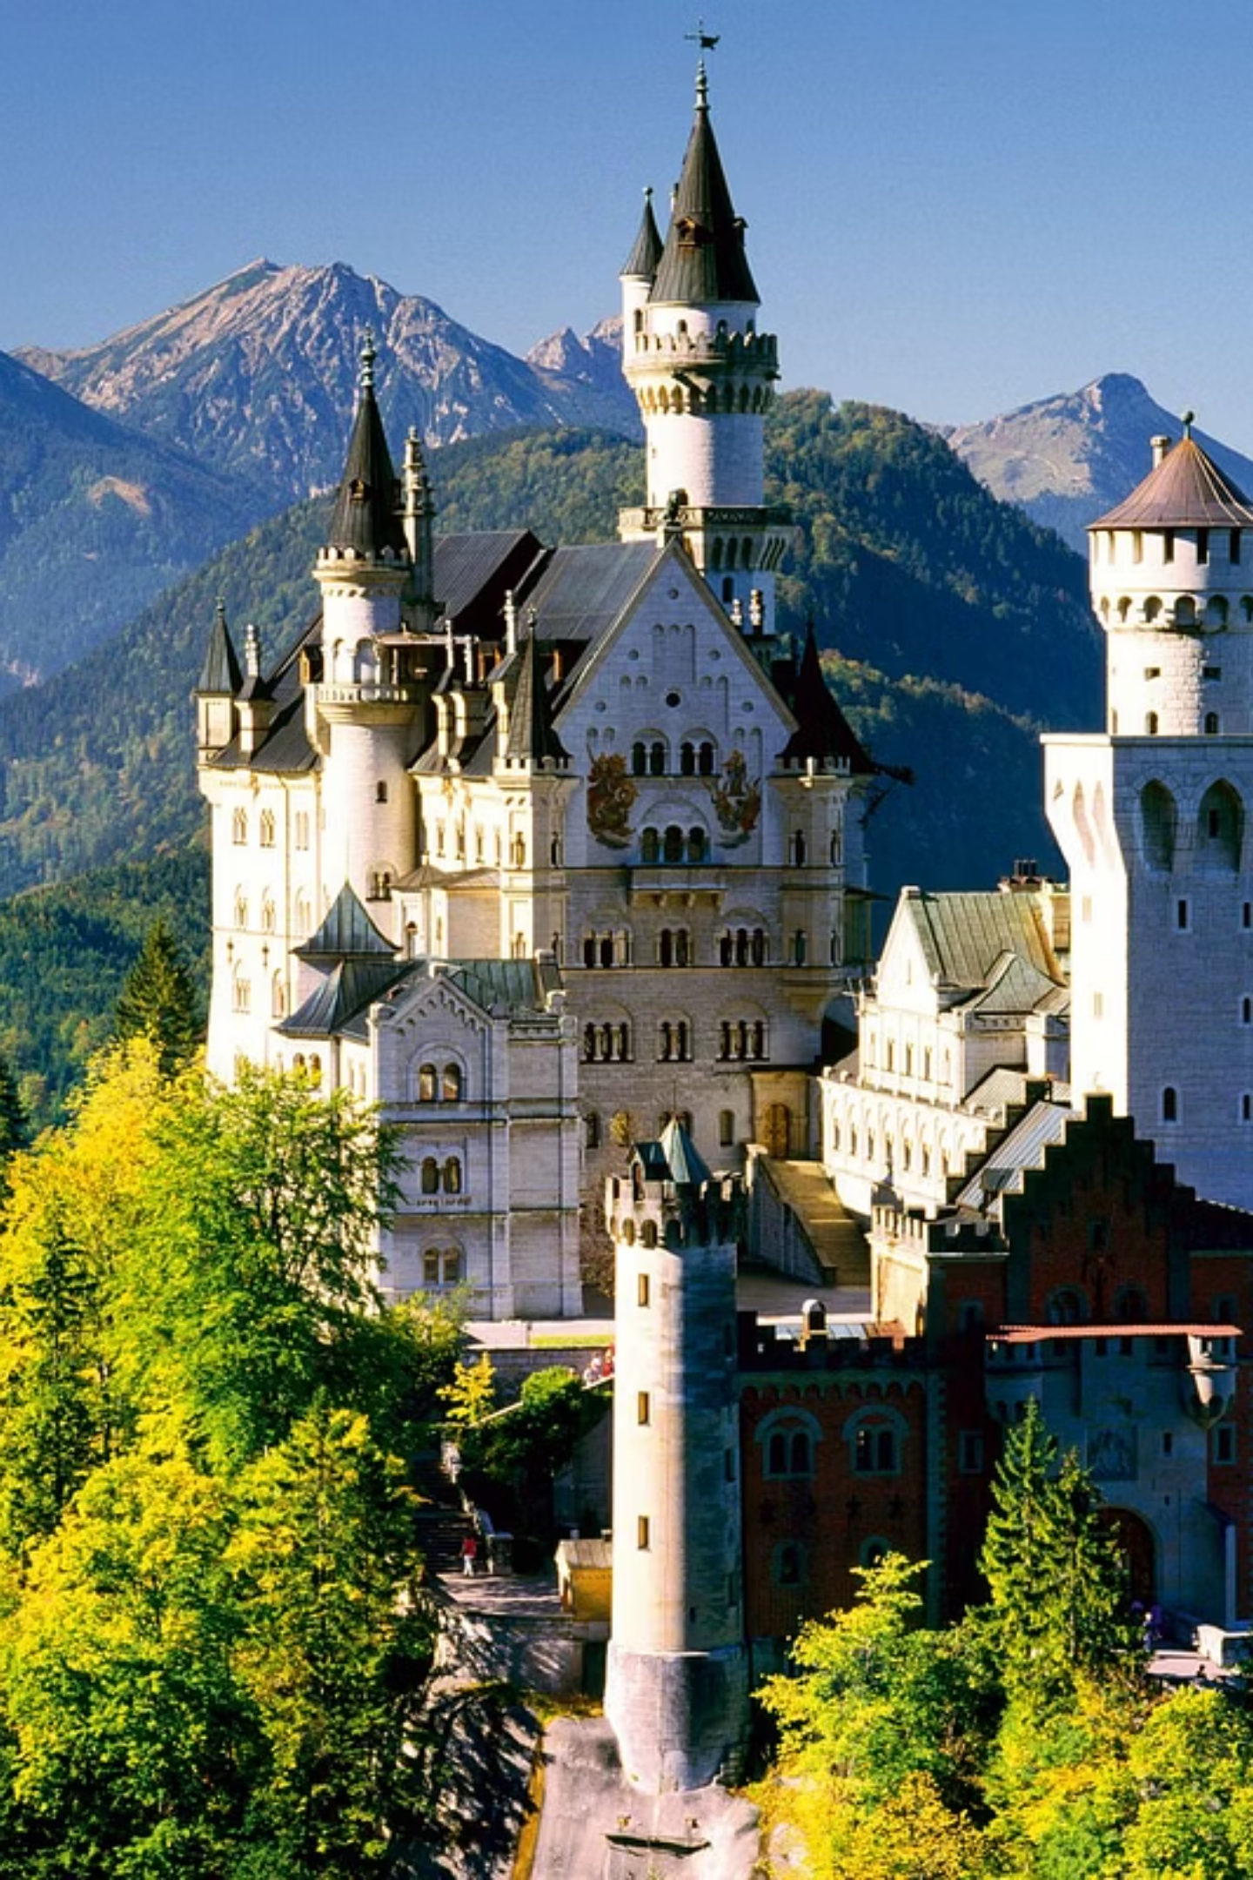




Limited Government & Separation of Powers
Western polyarchies embrace the concept of limited government, preventing overreach and concentrating power by dividing authority among distinct branches.
Executive
Legislature
Judiciary
Public
Oversees the implementation of laws and policies.
Responsible for creating and enacting new laws.
Interprets laws and administers justice accordingly.
The citizens who participate in the governance process.
This institutional division prevents abuses and maintains a balanced political system, fostering accountability and transparency.

Slide 6
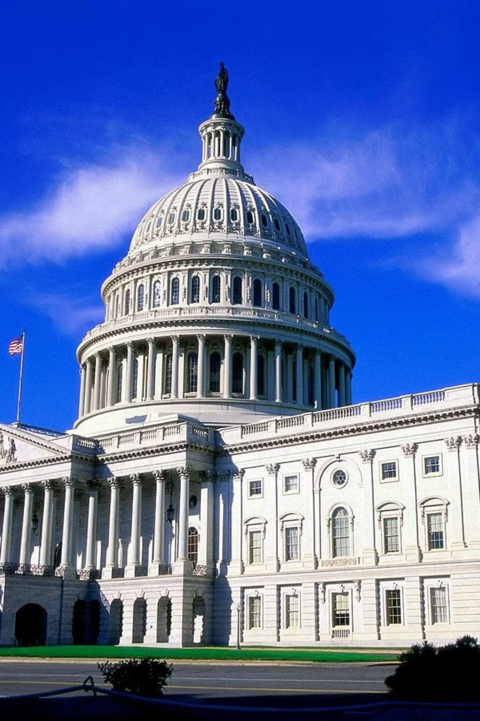
Checks and Balances in Action
To further ensure no single branch of government becomes overly dominant, many Western polyarchies employ sophisticated systems of checks and balances.
Bicameral Parliaments
Federal Systems
Two legislative houses collaborate in the law-making process, ensuring thorough scrutiny and representation.
Power is distributed among national, regional, and local governments, allowing for diverse governance tailored to local needs.

Slide 7
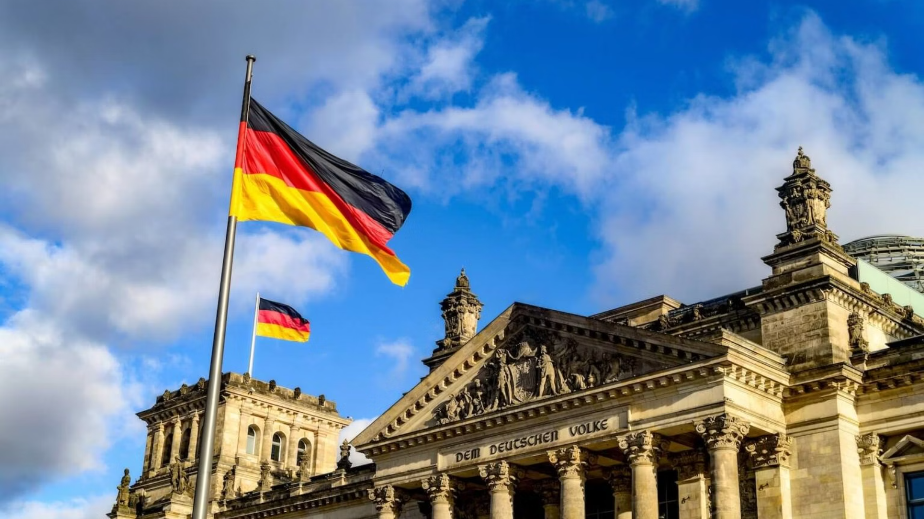


Economic Freedom & Social Welfare
A key characteristic of these systems is the support for market economies, coupled with a commitment to social provisions.
Market Economy
Social Services
Businesses operate freely, and individuals make their own economic choices, driving innovation and growth.
Governments often provide essential services such as healthcare and education, ensuring citizen well-being.

Slide 8

Diversity in Practice
While sharing foundational elements, each Western polyarchy possesses unique traditions and political cultures.
1
Majority Rule Focus
Some systems prioritise decisions reflecting the will of the largest group.
2
Inclusive Decision-Making
Others strive to involve a broad spectrum of societal groups in governance.
Despite these variations, the overarching goal remains consistent: to foster fair, stable, and participatory political systems.

Slide 9





The Enduring Promise
Western polyarchies, with their blend of free elections, individual rights, separation of powers, and economic freedom, represent a sophisticated approach to governance.
Free Elections
Individual Rights
Separation of Powers
Economic Freedom

Slide 10
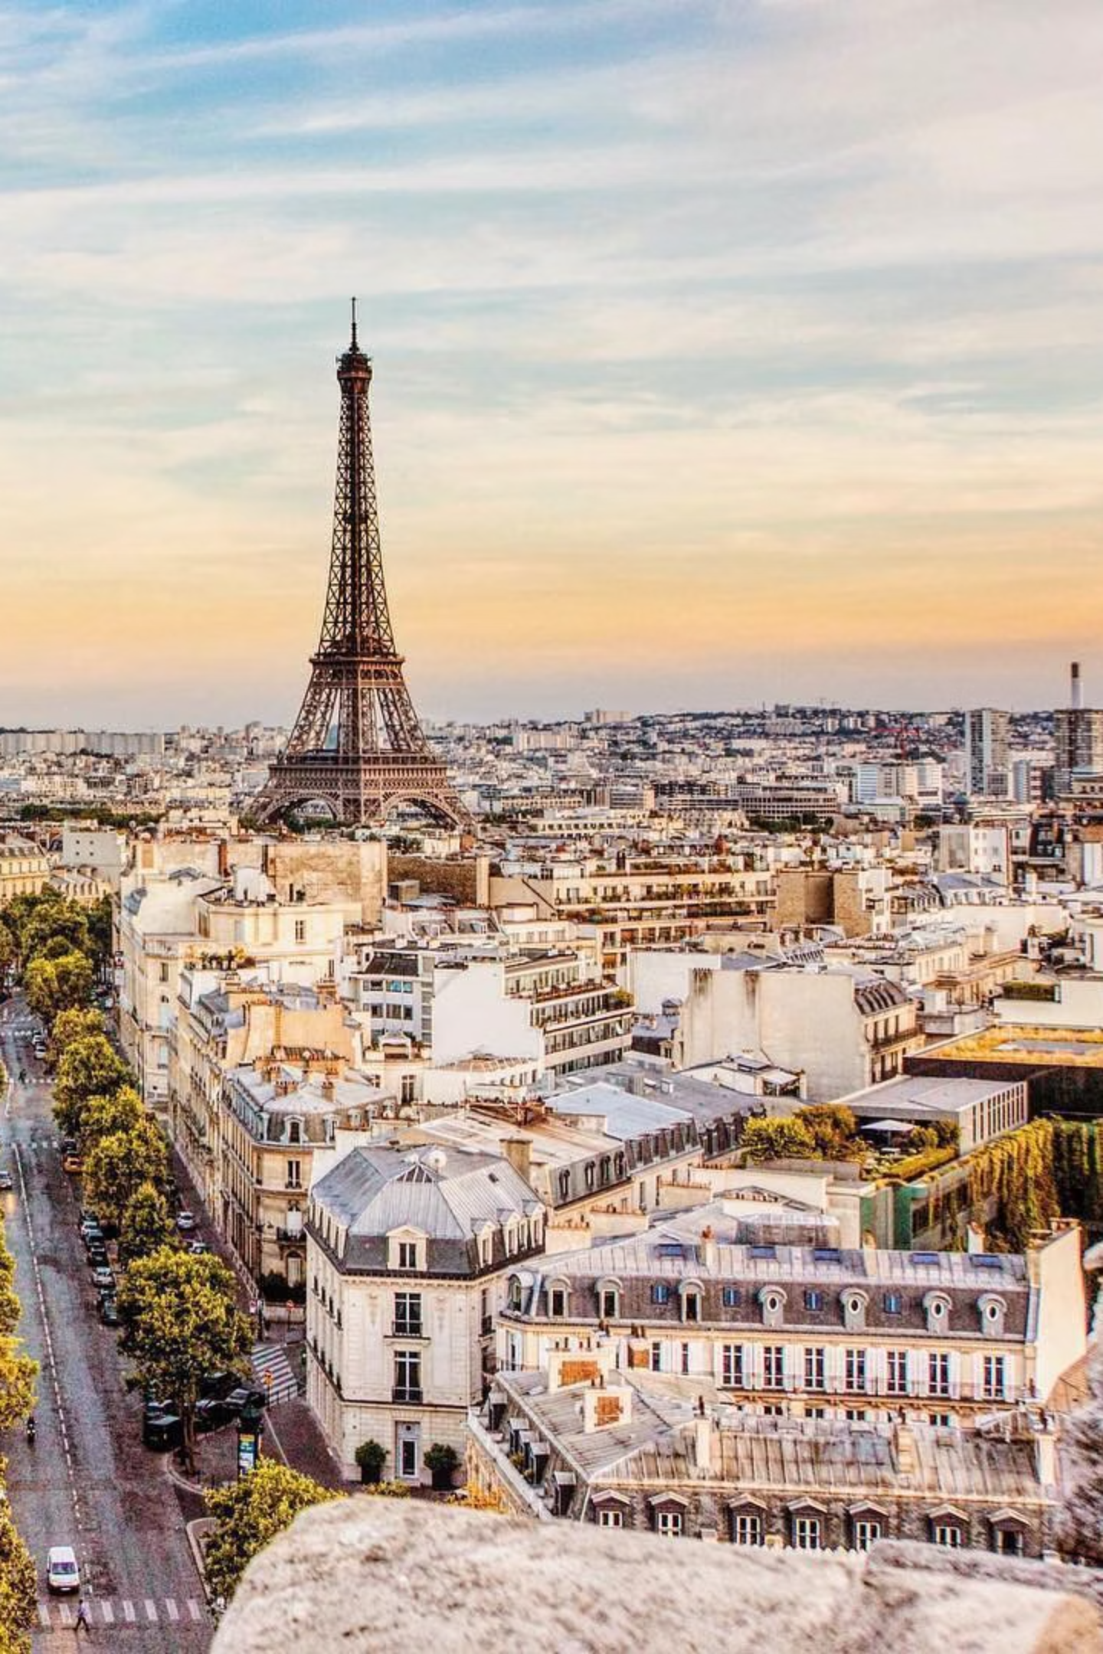
A Path Towards Liberty
While not without their imperfections, these systems provide ample opportunities for citizens to actively influence their governments and enjoy a high degree of personal liberty. They continue to evolve, striving for greater fairness and stability.

Slide 11
Thank you for your atention!
Vaganova Olga
Group № 3834101/30309

